Slide 1
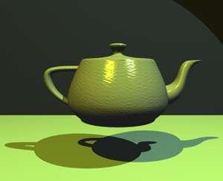

Introduction to Computer Graphics
Image: The Utah Tea pot, Finlay McWaiter
Brac University

Slide 2
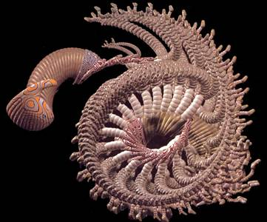
What is Computer Graphics?
Computer graphics generally means creation, storage and manipulation of models and images
Such models come from diverse and expanding set of fields including physical, biological, mathematical, artistic, and conceptual/abstract structures
Frame from animation by William Latham, shown at SIGGRAPH 1992. Latham creates his artwork using rules that govern patterns of natural forms.

Slide 3
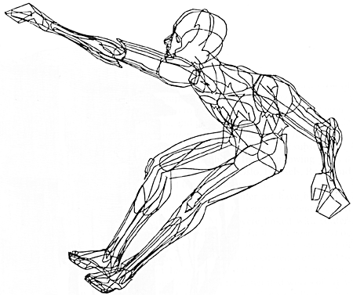
What is Computer Graphics?
William Fetter coined term “computer graphics” in 1960 to describe new design methods he was pursuing at Boeing for cockpit ergonomics
Created a series of widely reproduced images on “pen plotter” exploring cockpit design, using 3D model of human body.
“Perhaps the best way to define computer graphics is to find out what it is not. It is not a machine. It is not a computer, nor a group of computer programs. It is not the know-how of a graphic designer, a programmer, a writer, a motion picture specialist, or a reproduction specialist.
Computer graphics is all these – a consciously managed and documented technology directed toward communicating information accurately and descriptively.”
Computer Graphics, by William A. Fetter, 1966

Slide 4
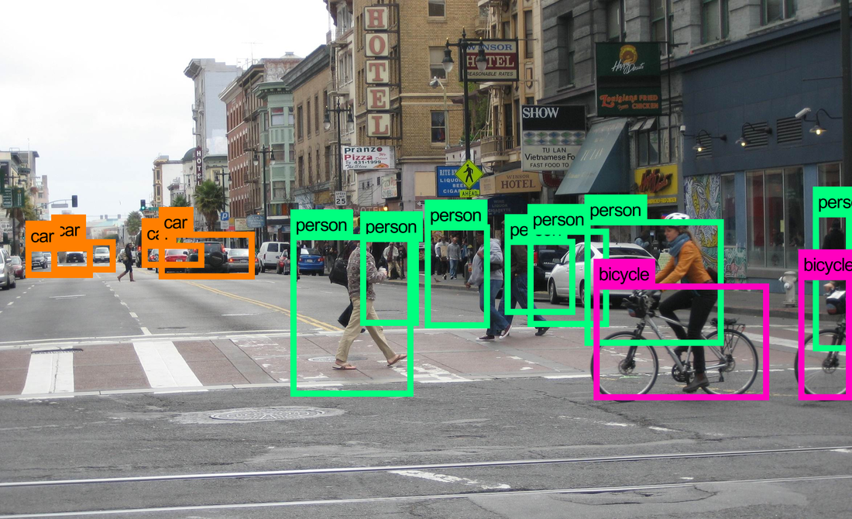

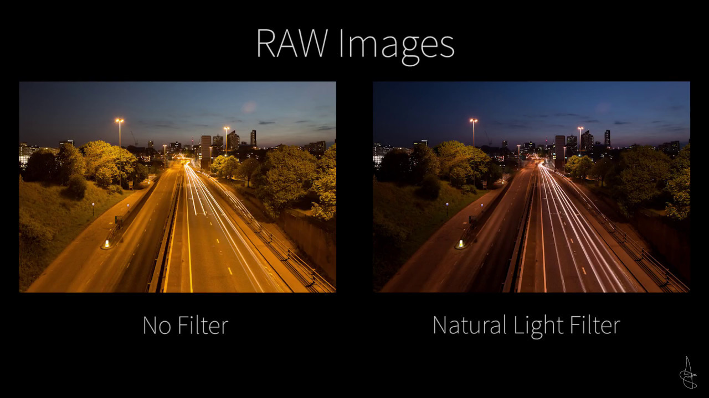
Differences
Computer vision: extracting information from the contents of an input image or video frame.
Ex: face recognition, autonomous driving
Computer graphics: creating an image from scratch using computer.
Ex: animated movies
Digital image processing: processing raw input images to perform different operations.
Ex: apply filter on an image, noise reduction, compression

Slide 5
Applications of CG
Entertainment:
Film and Animation: Used for creating visual effects, animations, and complex scenes.
Video Games: The backbone of interactive graphics for gameplay and VR/AR experiences.
Design and Engineering:
CAD (Computer-Aided Design): Used by engineers, architects, and designers to create models and simulations.
Product Design: Enables visualizing prototypes before physical production.
Education and Training:
Virtual Reality: Immersive educational environments for military, healthcare, and aerospace training.
Interactive Simulations: Learning tools for subjects like chemistry, physics, and biology.
Virtual and Augmented Reality:
VR/AR Applications: From gaming to real estate tours, virtual and augmented reality use computer graphics for immersive experiences

Slide 6
Applications of CG
Medical:
Medical Visualization: Graphics are used in imaging techniques (MRI, CT) and surgery simulations.
Telemedicine: Allows doctors to visualize patient scans remotely.
Scientific Research:
Data Visualization: Large datasets and complex information are represented graphically (e.g., graphs, charts, 3D models) to aid in analysis.
Astrophysics: Simulations of galaxies, planets, or black holes.
Advertising and Marketing:
Graphic Design: Creating logos, advertisements, and promotional material.
3D Product Visualization: Allows companies to showcase products in 3D for online retail
User Interfaces:
Graphical User Interfaces (GUIs): Found in operating systems, websites, apps, and software for user interaction with digital systems
Notes:
DeepFakes, Any Display

Slide 7

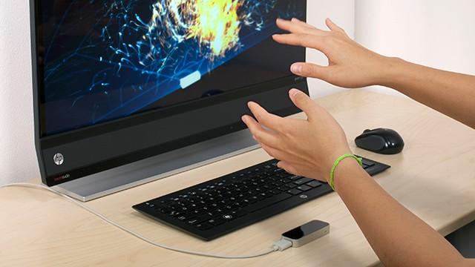

Input Methods in Computer Graphics
Keyboard and Mouse: Traditional devices for controlling software, navigation, and object manipulation.
Graphics Tablets: Used for digital drawing and illustration.
Touchscreens: For direct interaction with graphical elements.
3D Scanners: Capture the 3D structure of objects to create digital models.
Body as Interaction Device:
Xbox Kinect
Leap Motion
Nimble UX

Slide 8
Output Devices in Computer Graphics
Monitors and Screens: The most common output devices, used to display images and videos.
Printers: For generating hard copies of graphics (2D or 3D).
Projectors: Used in large-scale displays for presentations and entertainment.
VR/AR Headsets: Immersive displays for virtual and augmented reality applications.

Slide 9
Basic Definitions
Raster: A rectangular array of points or dots.
Pixel (Pel): One dot or picture element of the raster
Pixel Grid: Images are arranged in a grid of pixels, where each pixel is stored with specific color information (RGB values)
Scan line: A row of pixels
Video raster devices display an image by sequentially drawing out the pixels of the scan lines that form the raster.

Slide 10
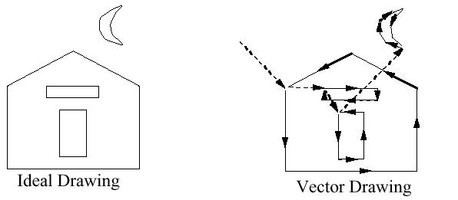


Graphics Display Hardware
Vector Display (calligraphic, stroke, random-scan)
Raster Display (TV, bitmap, pixmap) used in displays and laser printers
Driven by display commands
(move (x, y), char(“A”) , line(x, y)…)
Survives as “scalable vector graphics”
Driven by array of pixels (no semantics, lowest form of representation)
Note “jaggies” (aliasing errors) due to discrete sampling of continuous primitives
Ideal Drawing
Vector Drawing
Outline
Filled

Slide 11
Output Technology
Calligraphic Displays
also called vector, stroke or line drawing graphics
lines drawn directly on phosphor
display processor directs electron beam according to list of lines defined in a "display list“
phosphors glow for only a few micro-seconds so lines must be redrawn or refreshed constantly
deflection speed limits # of lines that can be drawn without flicker.

Slide 12
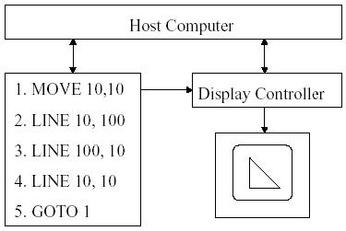
Vector Display Architecture

Slide 13
Output Technology
Raster Display
Display primitives (lines, shaded regions, characters) stored as pixels in refresh buffer (or frame buffer)
Electron beam scans a regular pattern of horizontal raster lines connected by horizontal retraces and vertical retrace
Video controller coordinates the repeated scanning
Pixels are individual dots on a raster line

Slide 14
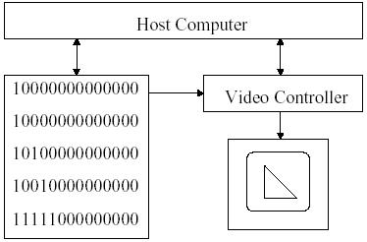
Raster displays Architecture

Slide 15
Output Technology
A pixel is the smallest unit of a digital image, representing a single color
Bitmap is the collection of pixels. Bitmap files are large because they store information for each pixel, often used in formats like .bmp, .png, and .jpg
Frame buffer stores the bitmap
Raster display stores the display primitives (line, characters, and solid shaded or patterned area)
Frame buffers
A portion of memory containing the image data that is to be displayed on the screen. The frame buffer stores the color values of every pixel in a scene, and its content is continuously scanned to the display device.
are composed of VRAM (video RAM).
VRAM is dual-ported memory capable of
Random access
Simultaneous high-speed serial output: built-in serial shift register can output entire scanline at high rate synchronized to pixel clock.

Slide 16
Frame Buffer
A frame buffer is characterized by its size, x, y, and pixel depth.
the resolution of a frame buffer is the number of pixels in the display. e.g. 1024x1024 pixels.
Bit Planes or Bit Depth is the number of bits corresponding to each pixel. This determines the color resolution of the buffer.
Dual ported (simultaneously writing values and displaying in the monitor)
Bilevel or monochrome displays have 1 bit/pixel (128Kbytes of RAM)
8bits/pixel -> 256 simultaneous colors 24bits/pixel -> 16 million simultaneous colors

Slide 17
Raster vs. Vector Displays
Raster: Pixel-based, fixed resolution, common in displays. Cheaper. More realistic.
Vector: Shape-based, resolution-independent, best for scalable designs.
Use Cases: Raster is used for photographs and complex images, while vector is used for fonts and logos.

Slide 18
Rendering Pipeline Overview
Definition: The rendering pipeline is a sequence of steps used in computer graphics to convert a 3D scene into a 2D image on the screen.
Key Steps in the Pipeline:
3D Model Creation: Define objects and scenes using geometry (vertices, polygons).
Transformation: Position, rotate, and scale 3D models in the scene.
Lighting: Simulate how light interacts with objects, adding realism.
Projection: Convert the 3D scene into a 2D viewable plane.
Rasterization: Convert vector-based models into pixels on the screen.
Shading & Texturing: Apply colors, textures, and lighting to pixels for final output.

Slide 19
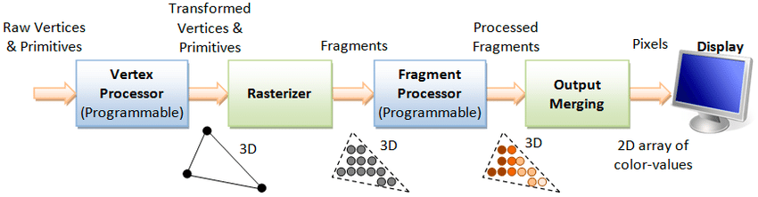
Stages of the Rendering Pipeline
Vertex Processing: Transform object coordinates to screen coordinates (includes model and view transformations).
Clipping: Remove objects or parts of objects outside the viewable area (camera's field of view).
Rasterization: Convert 3D objects into 2D pixel data, forming a pixel grid.
Fragment Processing: Apply effects like shading, textures, and lighting to individual pixels (fragments).
Image Composition: Combine layers and objects into the final image displayed on the screen.

Slide 20
Computations
Calculating Pixels:
If you have a screen resolution of 1920 x 1080 (Full HD), the total number of pixels in one frame can be calculated as:
Total Pixels = Width × Height
Total Pixels = 1920 × 1080 = 2,073,600 pixels per frame
So, a 1920 x 1080 resolution video frame contains 2,073,600 pixels.
Calculating Data per Second from FPS:
Let’s assume you are capturing a video at 60 frames per second (FPS). If each frame is 1920 x 1080 pixels, and you want to know how many pixels are processed per second, you multiply the total number of pixels per frame by the FPS:
Total Pixels per Second = Pixels per Frame × FPS Pixels per Second
= 2,073,600 × 60 = 124,416,000 pixels per second,
for a 1920 x 1080 video running at 60 FPS, 124,416,000 pixels are being processed every second.

Slide 21
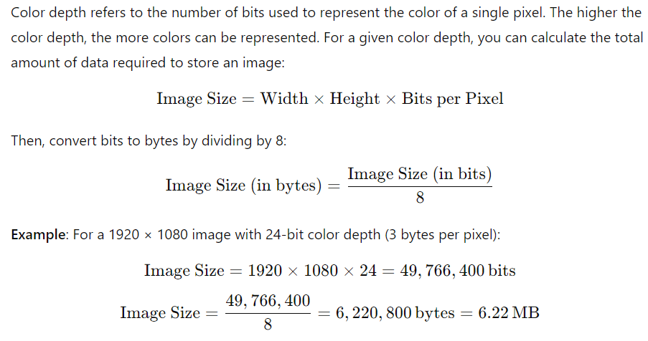
Computations
Aspect Ratio: The aspect ratio is the ratio of the width to the height of an image or screen:
Aspect Ratio = Width/Height
​ Example: For a resolution of 1920 × 1080 (Full HD):
Aspect Ratio=1920/1080=16:9
Color Depth and Image Size:

Slide 22
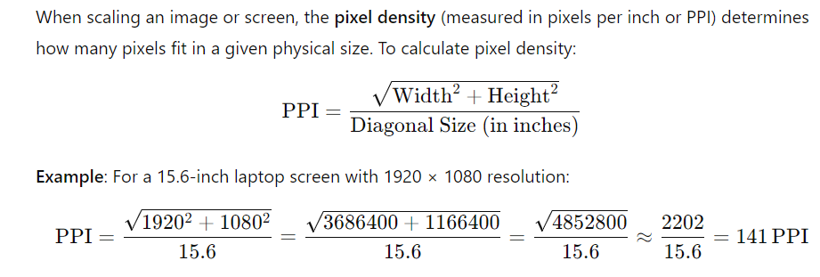
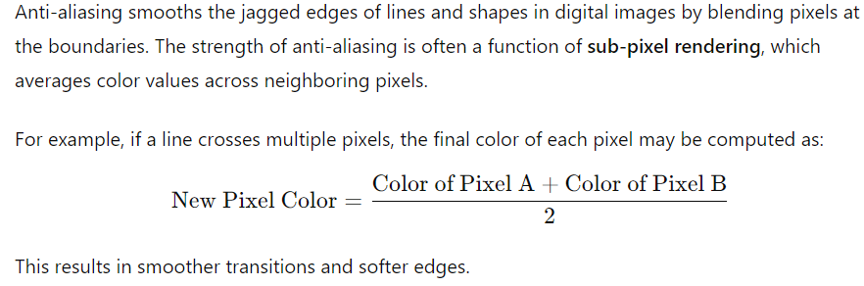
Computations
Scaling and Pixel Density (DPI/PPI)
Anti-aliasing:

Slide 23
Computations
Frame Time and Pixel Processing:
In real-time graphics, the time to render each frame (frame time) affects how long it takes to process pixels. At 60 FPS, the time to render one frame is approximately 16.67 milliseconds (time per frame = 1/FPS = 1/60 = 16.67 ms).
If a GPU can process N pixels per millisecond, you can estimate the maximum number of pixels that can be rendered per frame:
Pixels per Frame = N × 16.67
Example: If a GPU can process 100,000 pixels per millisecond:
Pixels per Frame = 100,000×16.67 = 1,667,000 pixels per frame
This number can be compared with the resolution to see if the GPU can handle rendering the entire frame in real-time.

